Slide 1

Small Mobile Project
Internship Evaluation

Slide 2
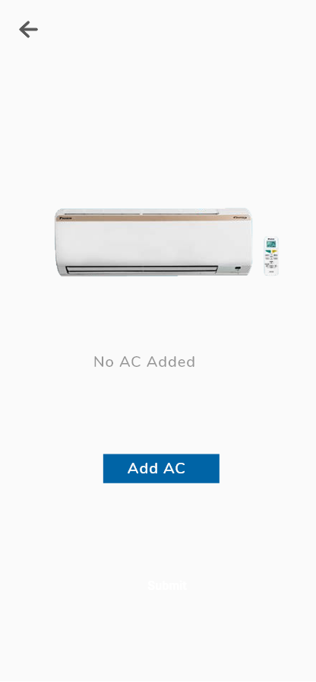
1
This is the home screen which the user will get when he/she opens the app for first time.
you may use any AC image.
Add AC button must be active.
On tapping it user should land to the next screen.

Slide 3
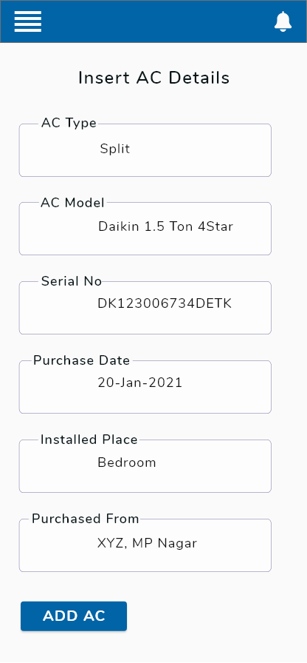
2
This screen will allow the user to add ACs.
Once user fills this form and taps on Add AC button he/she will go to next screen
CONTROL NAME | CONTROL TYPE | VALUES
AC type | dropdown | Window, Split
AC model | Text
Serial No | Text
Purchase Date | Date
Installed Place | Text
Purchased From | Text

Slide 4
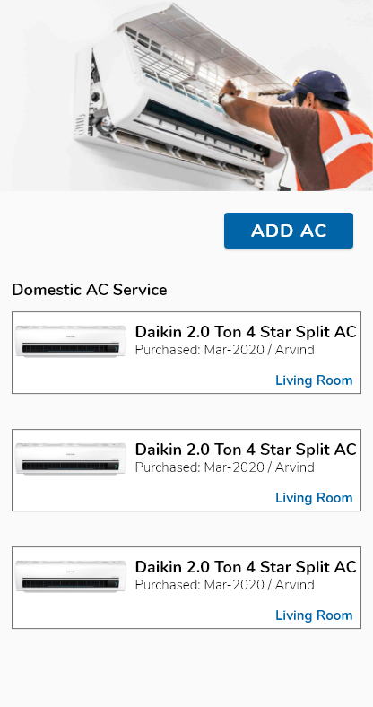
3
This is the updated home screen after some ACs have been added.
User can see the details of the AC added by them.
You can use representative pictures for Window and Split AC
Tapping on Add AC button here will take the user back to Screen-2

Slide 5
NOTES
You can develop app on either Android or iOS platforms
The app should be developed using native technology
Project submission last date is 19th June’21

